Slide 1




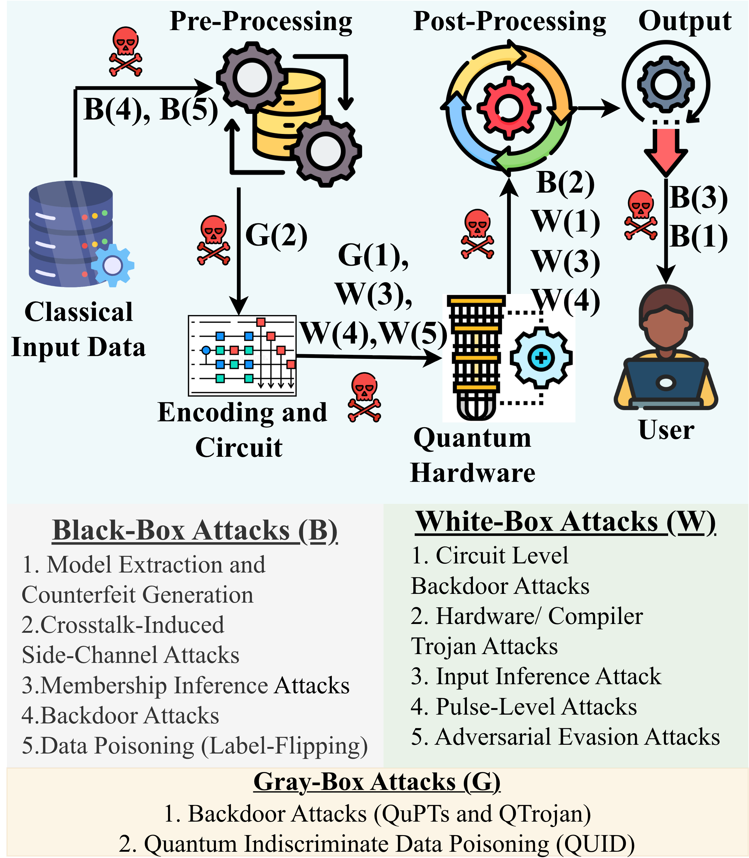
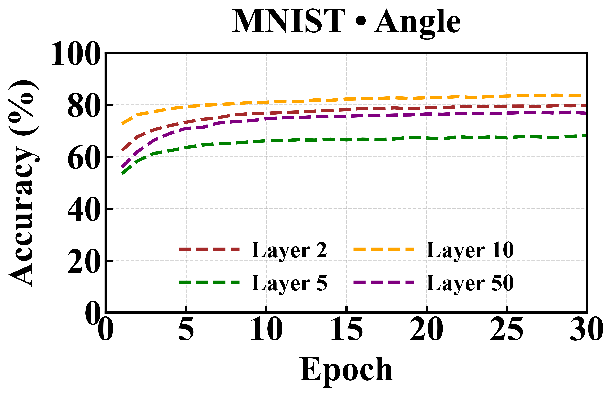
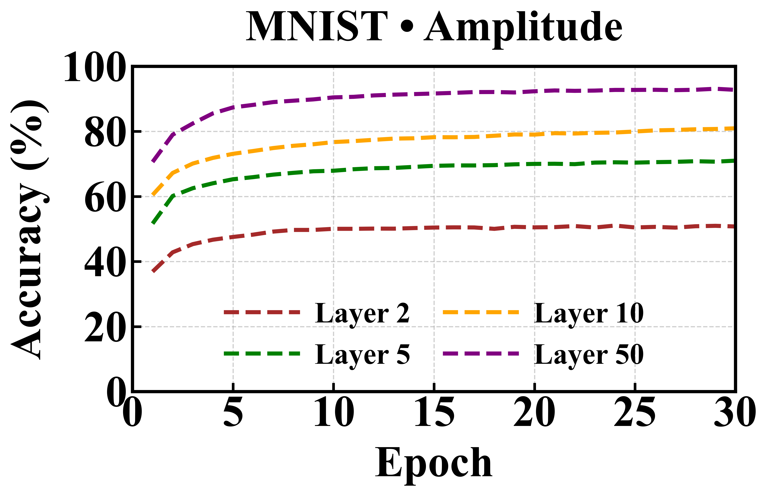
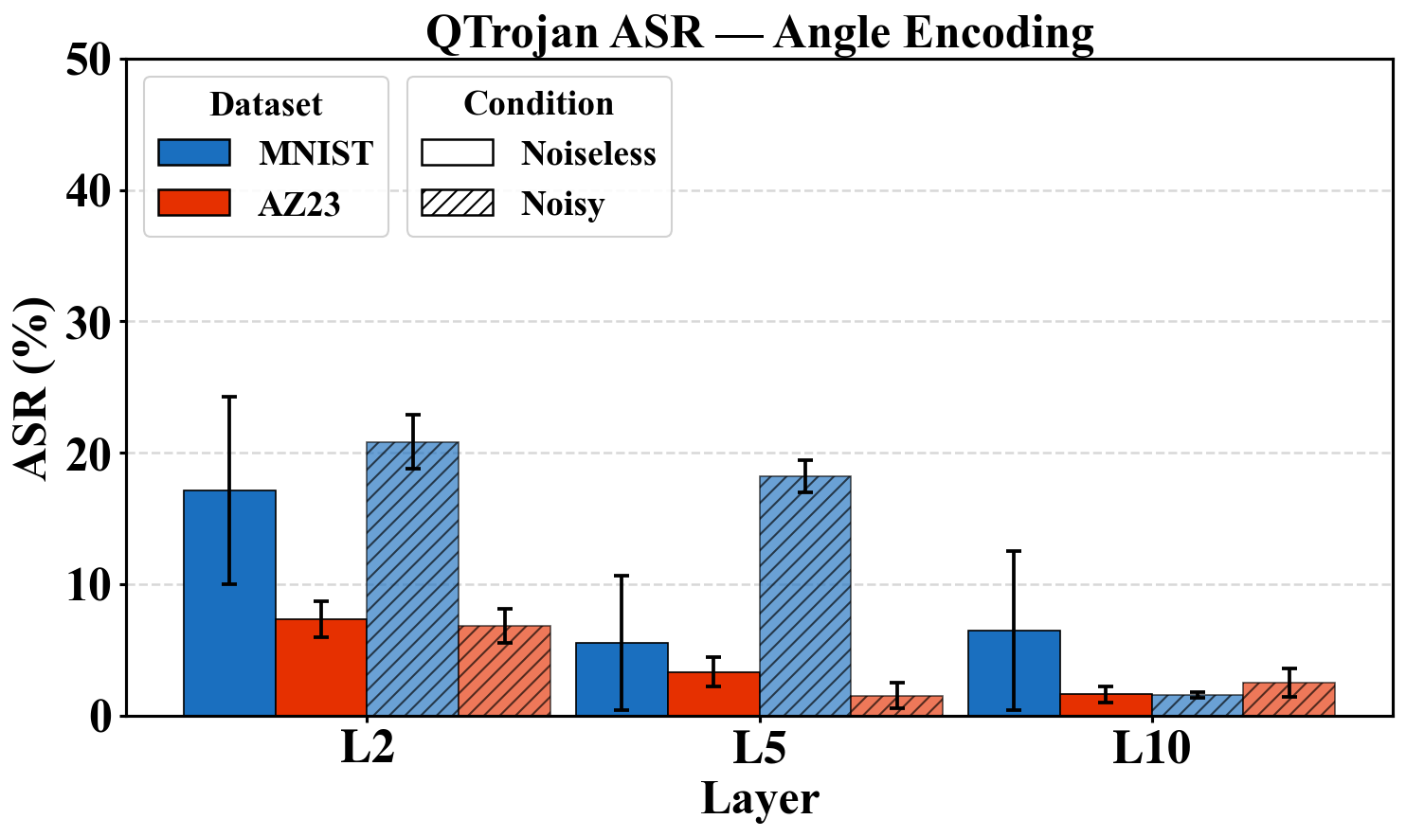
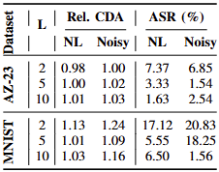
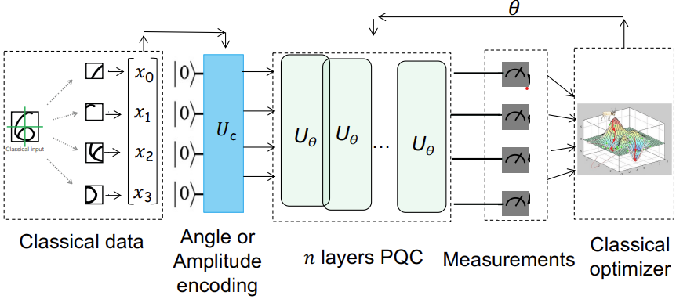
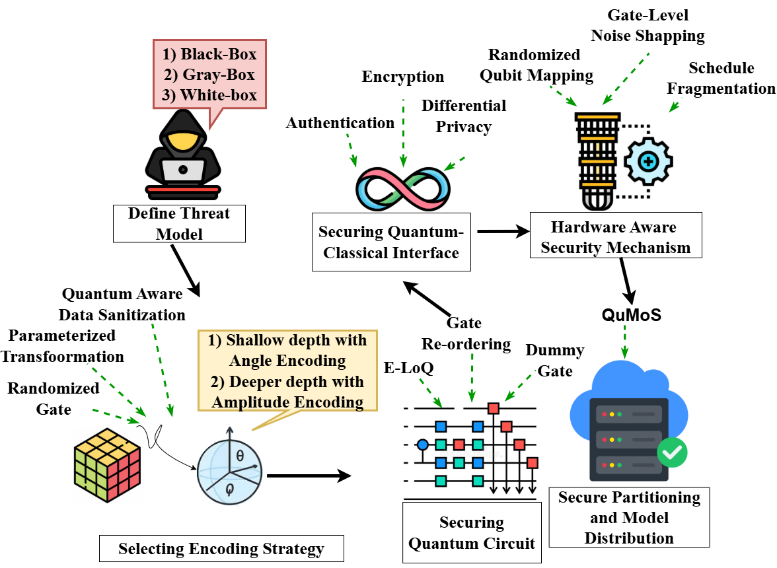
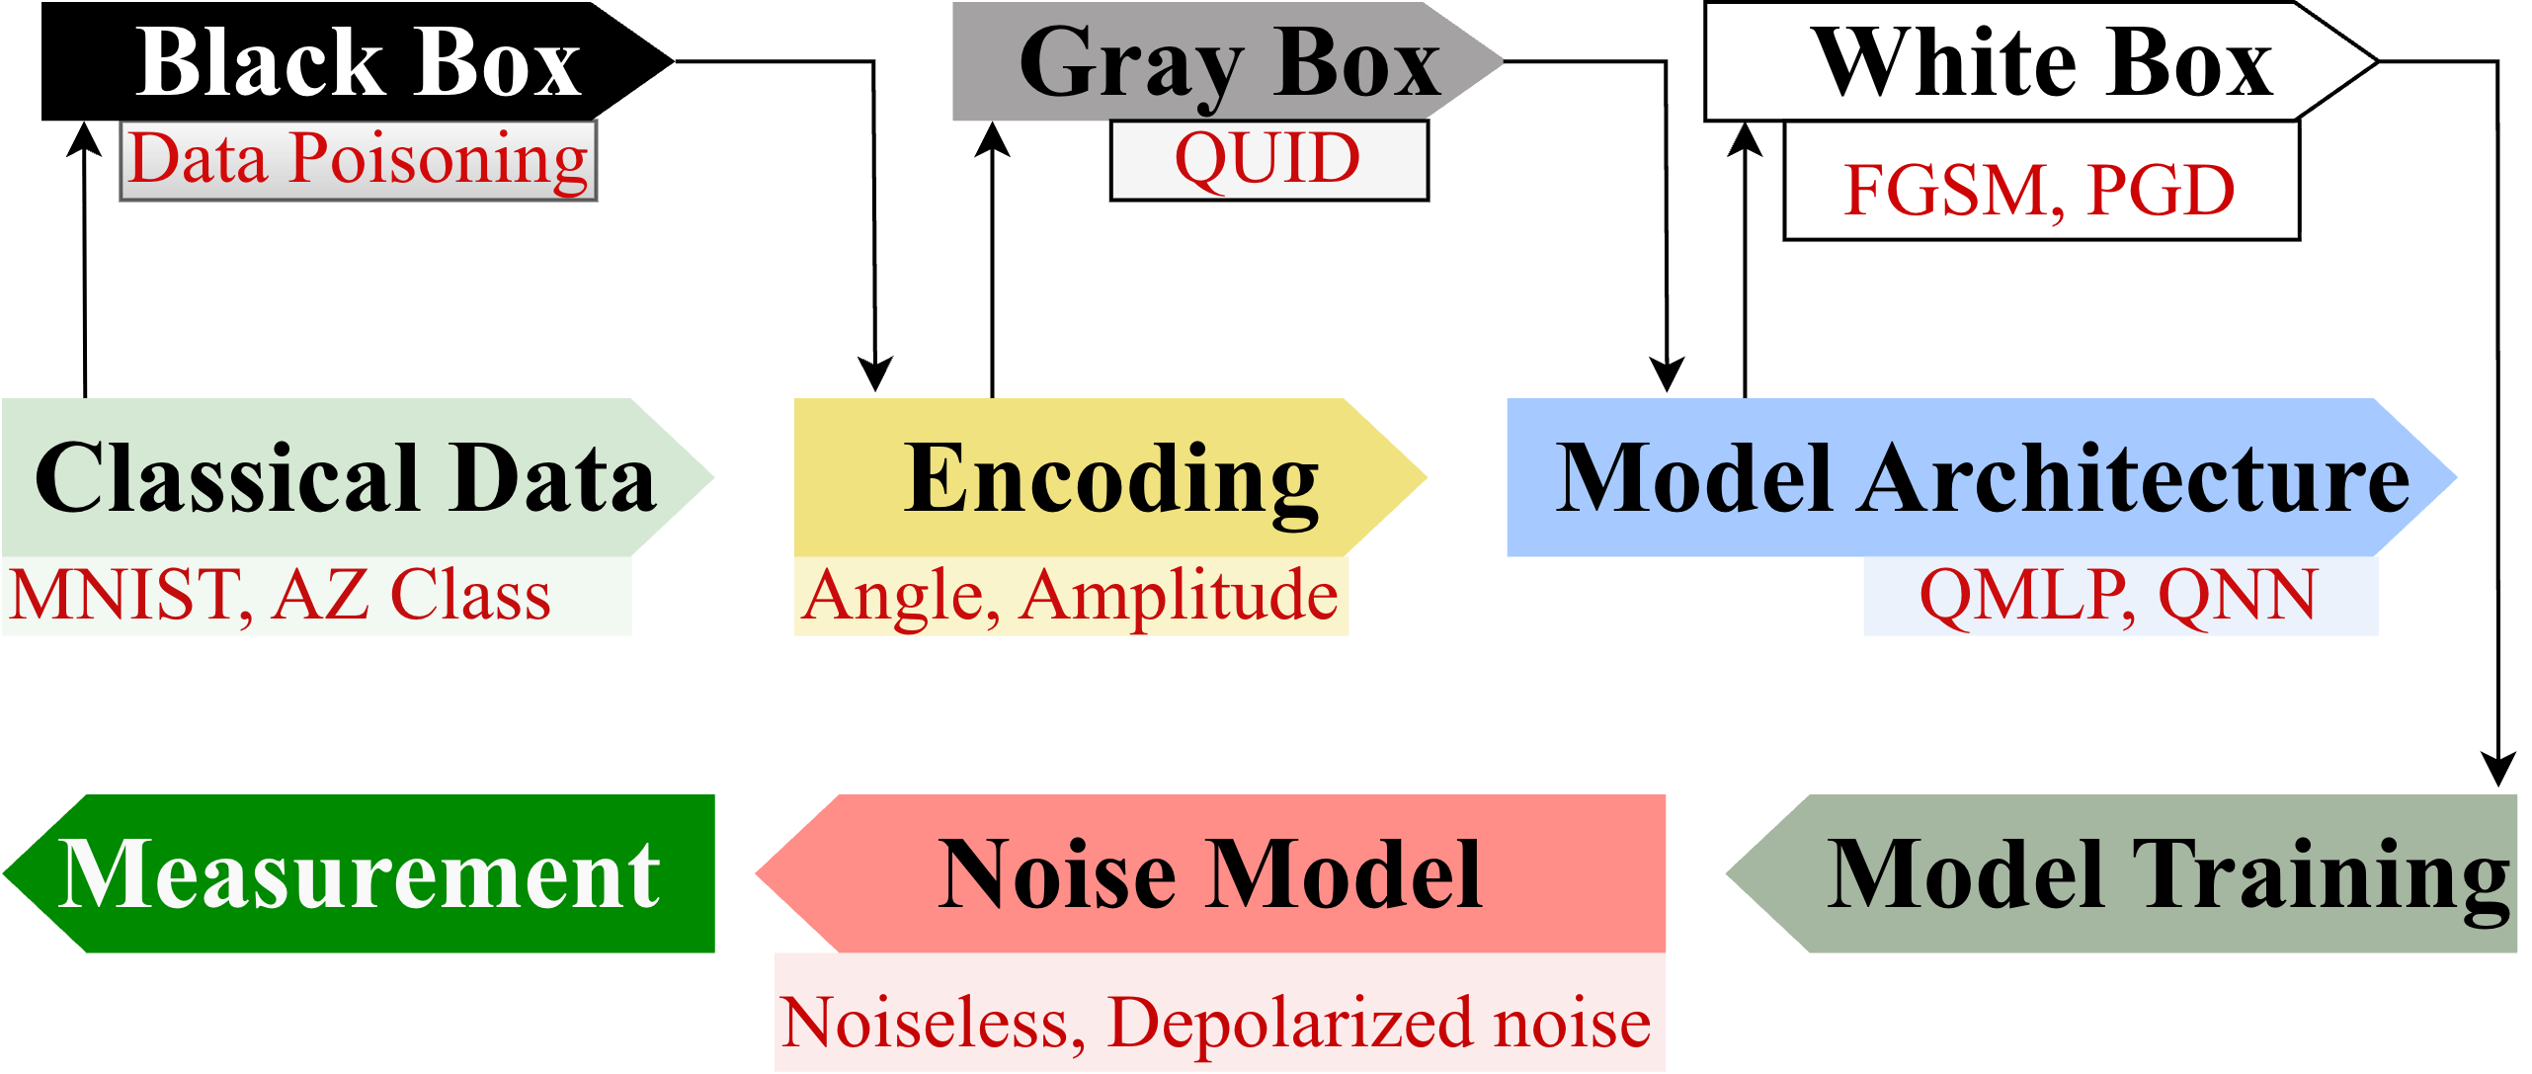
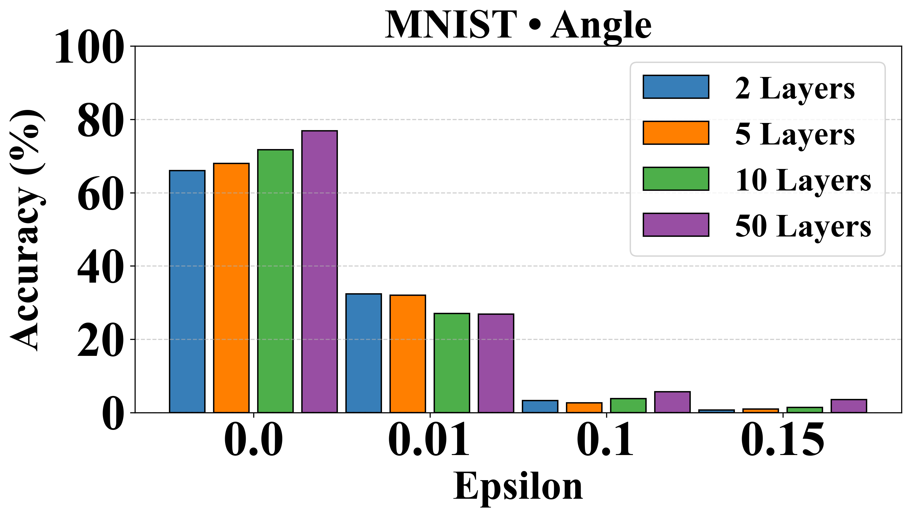
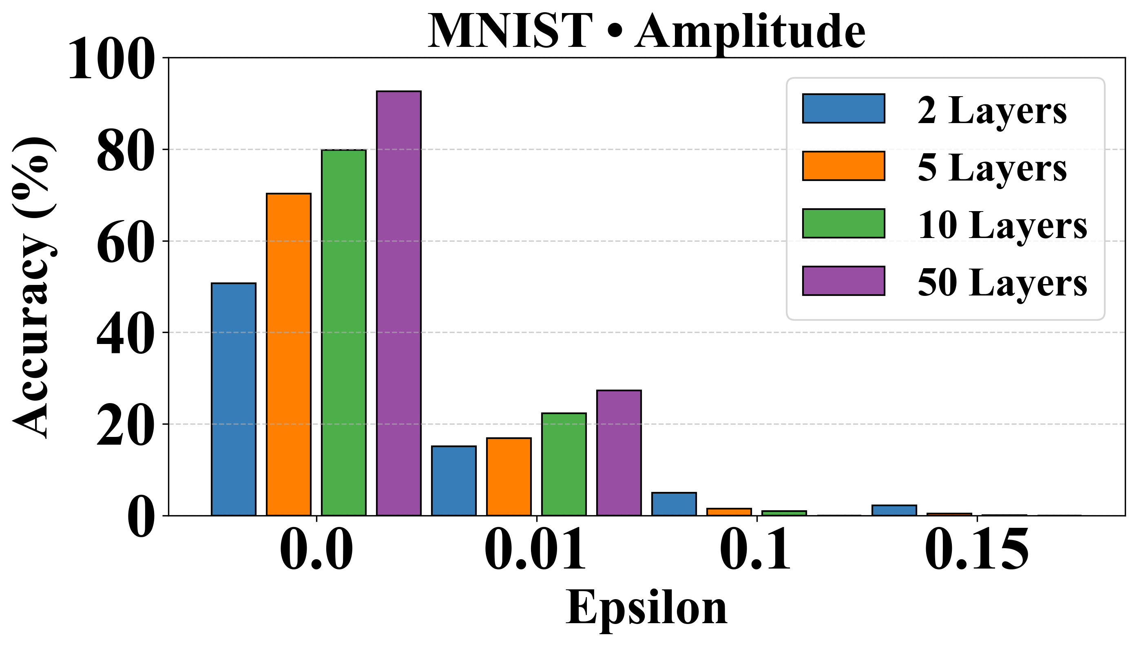

Critical Evaluation of Quantum Machine Learning
for Adversarial Robustness
Saeefa Rubaiyet Nowmi∗, Jesus Lopez∗, Md Mahmudul Alam Imon†, Shahrooz Pouryousef‡, Mohammad Saidur Rahman∗
∗University of Texas at El Paso, †University of Dhaka, ‡University of Massachusetts Amherst
Attack Taxonomy
Introduction
QTrojan is stealthy but fails to scale, with low attack success (~17%) despite high accuracy
Angle encoding favors shallow circuits (highest accuracy gain for 10layer PQC)
Deep amplitude encoded circuits achieve the best accuracy. But for NISQ devices, shallow angle encoded circuits are the most optimal choice.
Quantum Machine Learning (QML)
Quantum computational principles → learning algorithms
Improved representational capacity
Security and robustness of QML remain largely underexplored
RQ1. Dominant threat vectors in hybrid quantum-classical architectures and their systematic classification.
RQ2. Effects of circuit depth and data encoding on QML performance and adversarial robustness under NISQ constraints.
RQ3. Resiliency of current QML models and defenses against diverse attacks.
Qtrojan: Stealthy but fails to scale in multi-class classification
Parameterized Quantum Circuit as a QML model
Defense Pipeline
Compared to CML, Shallow Angle-Encoded QML more Robust to FGSM
Experimental Setup
Scan me!
Notes:
angle-encoded QMLP models are more robust to FGSM Amplitude-encoded models collapse under even small perturbations

